Slide 1






HTTP Protocol
Handling Requests, Constructing Responses, HTTP/2
Java Web Dev Basics
SoftUni Team
Technical Trainers
Software University
http://softuni.bg

Slide 2




Table of Contents

Slide 3
Questions
sli.do #java-web

Slide 4

MIME and Media Types
Multi-Purpose Internet Mail Extensions

Slide 5
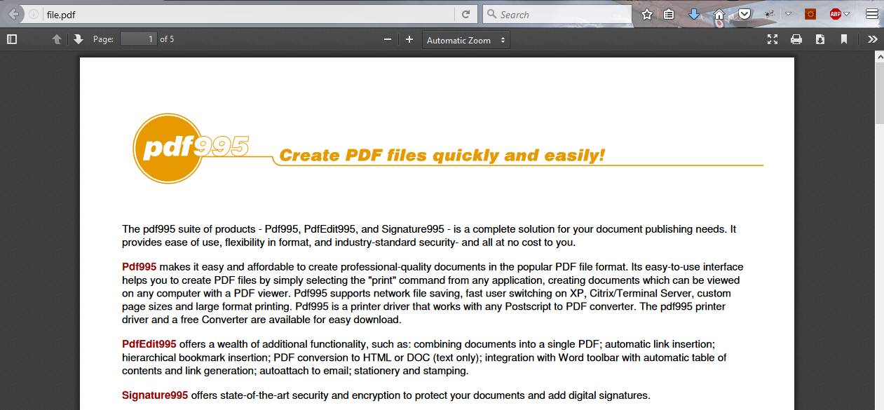
What is MIME?

Slide 6
What is MIME?
MIME == Multi-Purpose Internet Mail Extensions
Internet standard for encoding resources
Originally developed for email attachments
Used in many Internet protocols like HTTP and SMTP
MIME defines several concepts
Content-Type, e.g. text/html, image/gif, application/pdf
Content charset, e.g. utf-8, ascii, windows-1251
Content-Disposition, e.g. attachment; filename=logo.jpg
Multipart messages (multiple resources in a single document)

Slide 7
Common MIME Media Types
MIME Type / Subtype | Description
application/json | JSON data
image/png | PNG image
image/gif | GIF image
text/html | HTML
text/plain | Text
text/xml | XML
video/mp4 | MP4 video
application/pdf | PDF document

Slide 8

HTTP Request
What is a HTTP Request?

Slide 9
HTTP Request Message
Request message sent by a client consists of:
HTTP request line
Request method (GET / POST / PUT / DELETE / …)
Resource URI (URL)
Protocol version
HTTP request headers
Additional parameters
HTTP request body – optional data, e.g. posted form fields
<method> <resource> HTTP/<version>
<headers>
(empty line)
<body>

Slide 10
HTTP POST Request – Example
Example of HTTP POST request:
POST /login.html HTTP/1.1
Host: localhost
Content-Length: 59
<CRLF>
username=mente&password=top*secret!
<CRLF>
HTTP request line
HTTP request headers
The request body holds the submitted form data

Slide 11
HTTP GET Request – Example
Example of HTTP GET request:
HTTP request line
GET /index.html HTTP/1.1
Host: localhost
<CRLF>
HTTP request headers
The request body is empty

Slide 12
HTTP Response
What is a HTTP Response?

Slide 13
HTTP Response Message
The response message sent by the HTTP server consists of:
HTTP response status line
Protocol version
Status code
Status phrase
Response headers
Provide meta data about the returned resource
Response body
The content of the HTTP response (data)
HTTP/<version> <status code> <status text>
<headers>
<CRLF>
<response body – the requested resource>

Slide 14
HTTP Response – Example
Example of HTTP response from the Web server:
HTTP response status line
HTTP/1.1 200 OK
Date: Fri, 17 Jul 2010 16:09:18 GMT+2
Server: Apache/2.2.14 (Linux)
Accept-Ranges: bytes
Content-Length: 84
Content-Type: text/html
<CRLF>
<html>
<head><title>Test</title></head>
<body>Test HTML page.</body>
</html>
HTTP response headers
HTTP response body

Slide 15
HTTP Response Codes
HTTP response code classes
1xx: informational (e.g., "100 Continue")
2xx: successful (e.g., "200 OK", "201 Created")
3xx: redirection (e.g., "304 Not Modified", "301 Moved Permanently", "302 Found")
4xx: client error (e.g., "400 Bad Request", "404 Not Found", "401 Unauthorized", "409 Conflict")
5xx: server error (e.g., "500 Internal Server Error", "503 Service Unavailable")

Slide 16
HTTP Response – Example
Example of HTTP response with error result:
HTTP response status line
HTTP/1.1 404 Not Found
Date: Fri, 17 Nov 2014 16:09:18 GMT+2
Server: Apache/2.2.14 (Linux)
Connection: close
Content-Type: text/html
<CRLF>
<HTML><HEAD><TITLE>404 Not Found</TITLE></HEAD>
<BODY>
<H1>Not Found</H1>
The requested URL /img/logo.gif was not found on this server.<P> <HR><ADDRESS>Apache/2.2.14 Server at Port 80</ADDRESS>
</BODY></HTML>
HTTP response headers
The HTTP response body

Slide 17
Browser Redirection
HTTP GET requesting a moved URL:
The following HTTP response (301 Moved Permanently) tells the browser to request another URL:
GET / HTTP/1.1
Host: http://softuni.org
User-Agent: Gecko/20100115 Firefox/3.6
<CRLF>
HTTP/1.1 301 Moved Permanently
Location: http://softuni.bg
…

Slide 18
Content-Type and Disposition
The Content-Type response header the server specifies how the output should be processed
Examples:
UTF-8 encoded HTML page. Will be shown in the browser.
Content-Type: text/html; charset=utf-8
Content-Type: application/pdf
Content-Disposition: attachment; filename="Report-April-2016.pdf"
This will download a PDF file named Report-April-2016.pdf

Slide 19

HTTP/2
What’s new? What’s better? What’s HTTP/2

Slide 20

What’s HTTP/2
HTTP/2 (originally named HTTP/2.0) major revision of the HTTP network protocol used by the World Wide Web.
Supported by most of the popular web browsers (Chrome, Mozilla, Opera...)
Fast & Optimized. Meets modern web usage requirements.
Completely Backwards-Compatible.
As of November 2017, 20.5% of the top 10 million websites support HTTP/2 (W3Techs statistics).

Slide 21

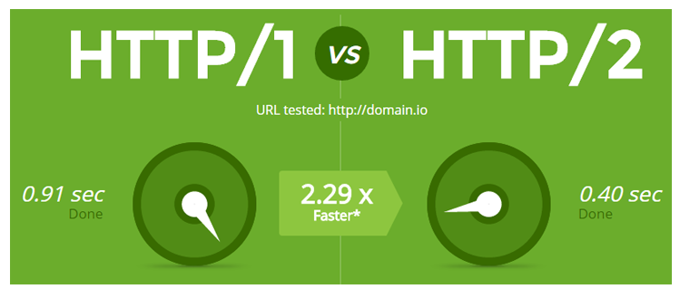
What’s new?
HTTP/2 is meant to erase the need of maintaining complex server infrastructures in order to perform well.
HTTP/2 communicates in binary data frames.
HTTP/2 introduces several new important elements:
HTTP/2 Multiplexing
HTTP/2 Header Compression
HTTP/2 Server Push

Slide 22
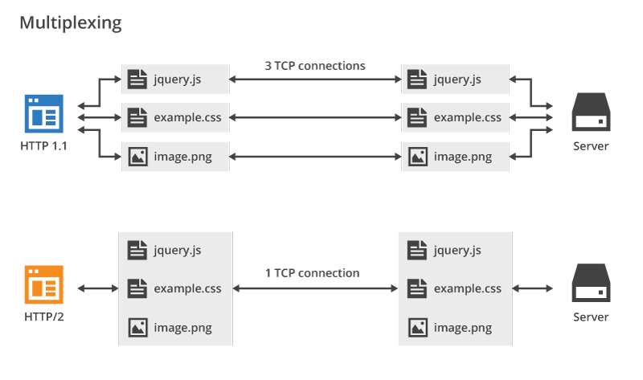
HTTP/2 Multiplexing
The art of handling multiple streams over a single TCP connection.

Slide 23
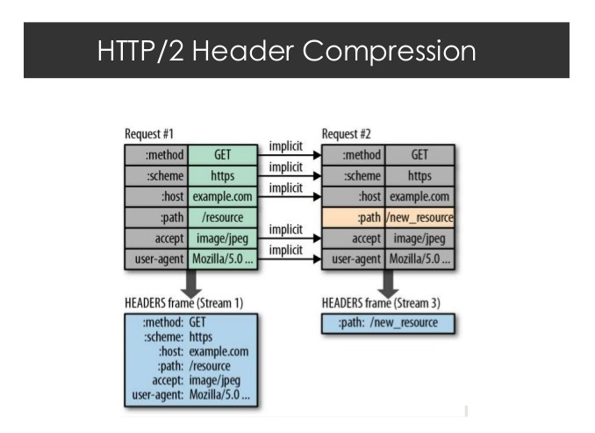
HTTP/2 Header Compression
HTTP/2 maintains a HTTP Header Table across requests.
Optimizes communication drastically.
The process is essentially a de-duplication, rather than compression.

Slide 24
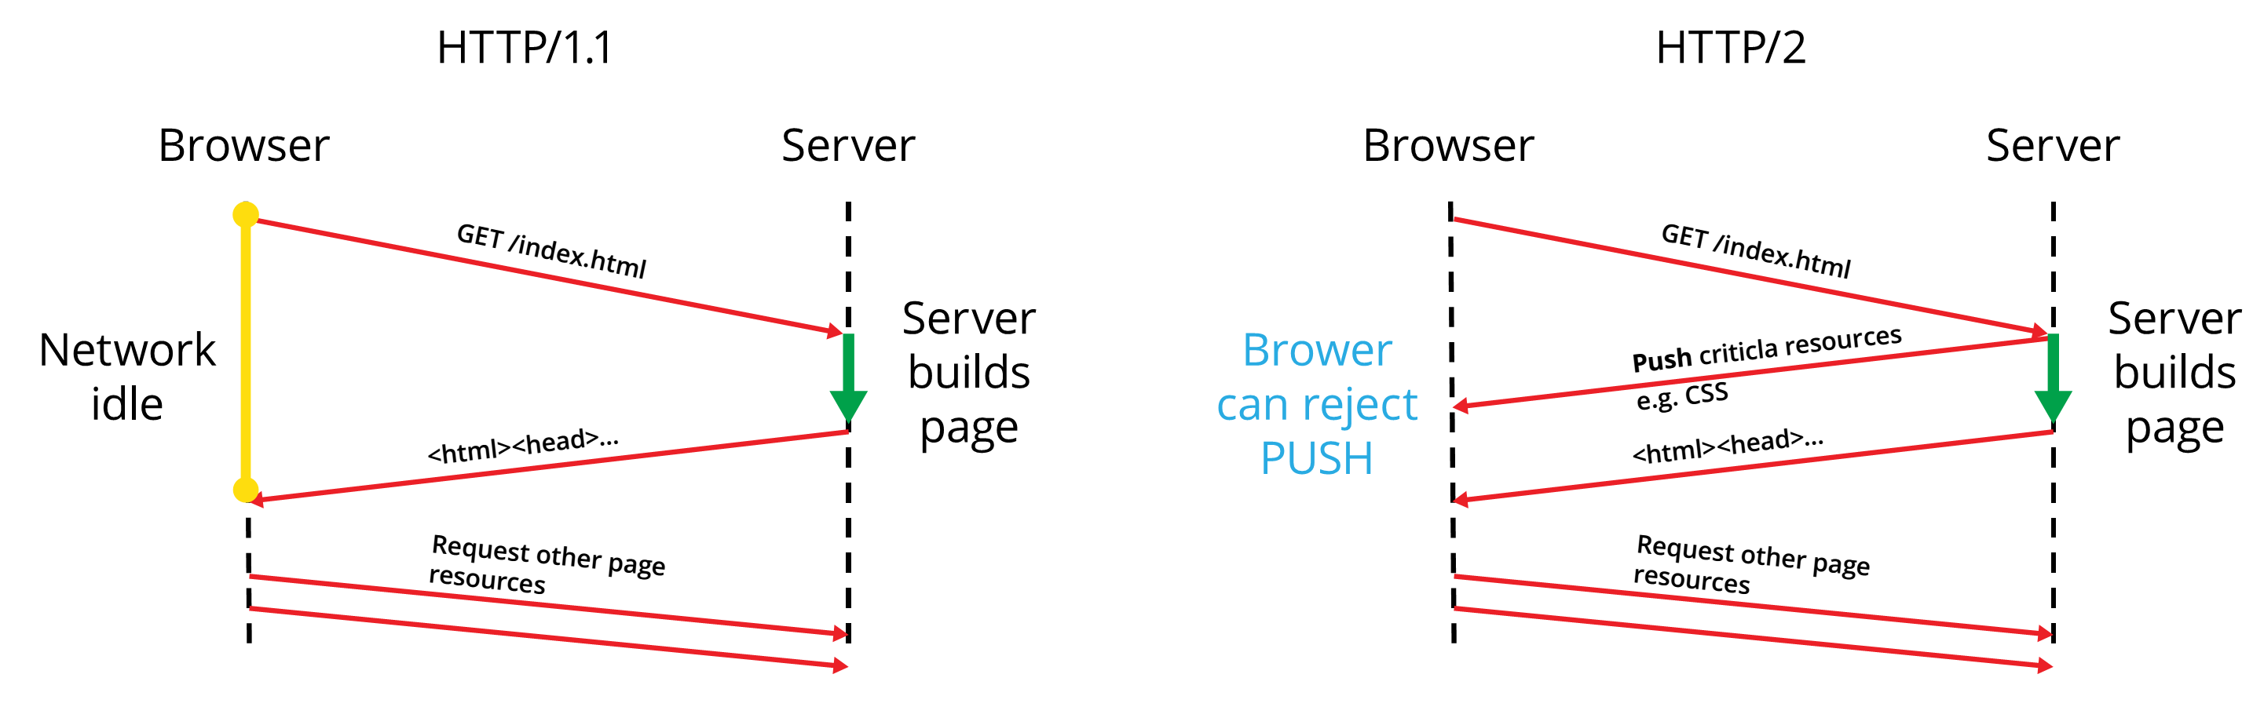
HTTP/2 Server Push
HTTP/2 Server Push is the process of sending resources to clients, without them having to ask for it.

Slide 25

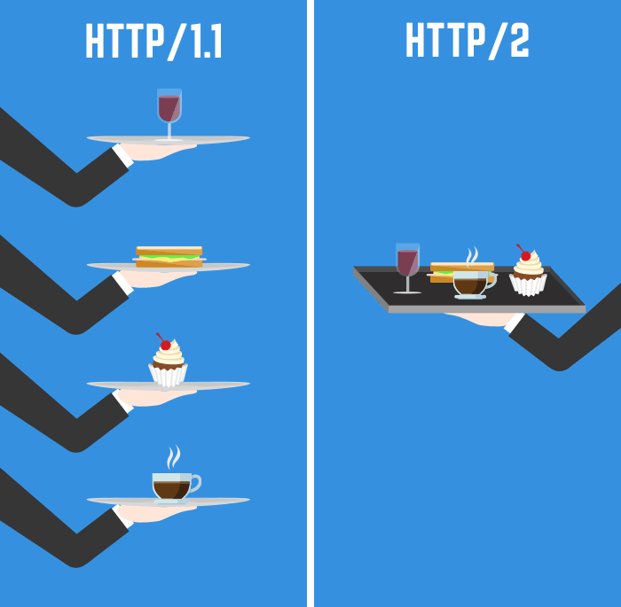

Summary
What is MIME?
How to handle HTTP Requests?
How to construct HTTP Responses?
What is HTTP/2?
Multiplexing
Header Compression
Server Push

Slide 26







Java Web Dev Basics – HTTP Protocol
https://softuni.bg/courses/java-web-development-basics

Slide 27
License
This course (slides, examples, demos, videos, homework, etc.) is licensed under the "Creative Commons Attribution-NonCommercial-ShareAlike 4.0 International" license

Slide 28





Trainings @ Software University (SoftUni)
Software University – High-Quality Education, Profession and Job for Software Developers
softuni.bg
Software University Foundation
http://softuni.foundation/
Software University @ Facebook
facebook.com/SoftwareUniversity
Software University Forums
forum.softuni.bg

